Slide 1

Regression Testing
How to use Selenium IDE to document your application

Slide 2

What is Selenium IDE?
It is a FireFox plugin
You can download it for free
It allows you to record your browsing
It allows you to verify certain fields exist which makes it a testing tool also!
So let’s download it!

Slide 3
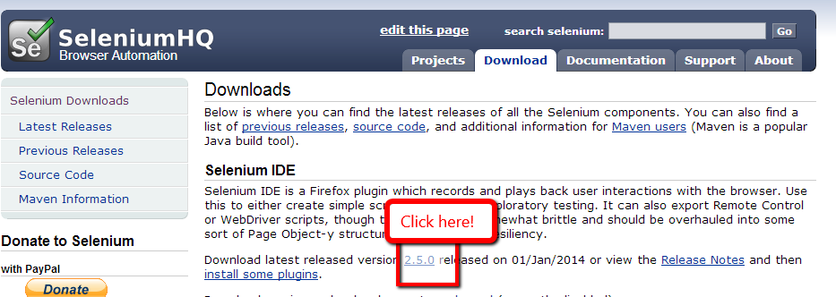
Getting the plug-in
First you must have FireFox browser
http://www.mozilla.org/en-US/firefox/new/
It would help if you have the Fireplug plugin
http://getfirebug.com/downloads
Then download Selenium IDE
http://docs.seleniumhq.org/download/

Slide 4
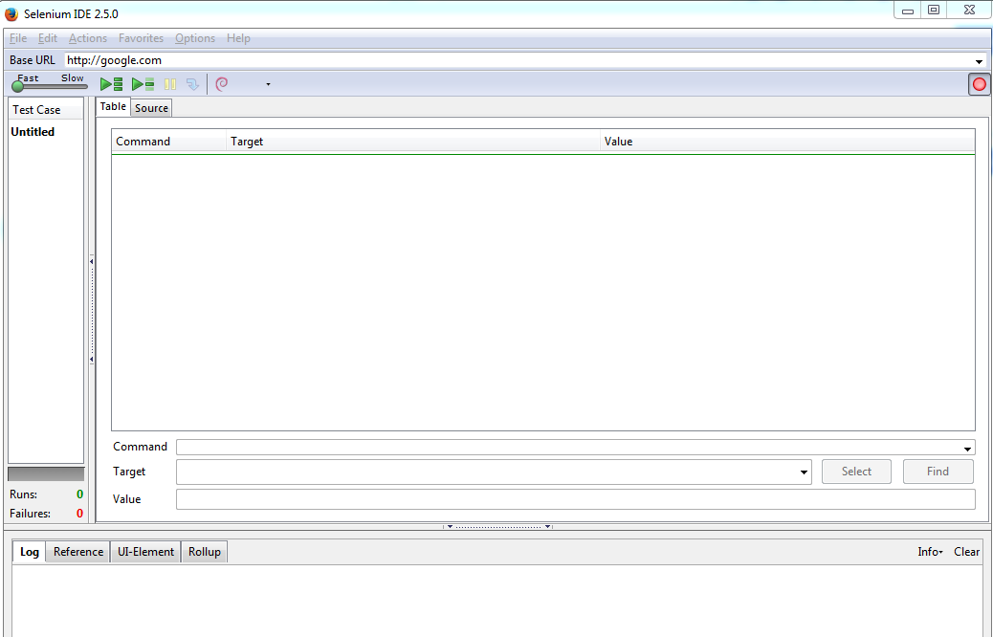
Now let’s try our first test
Open up Firefox
Go to google.com
Hold down the Alt-Control and S keys.
Selenium should appear
Enter http://google.com in the Base Url

Slide 5
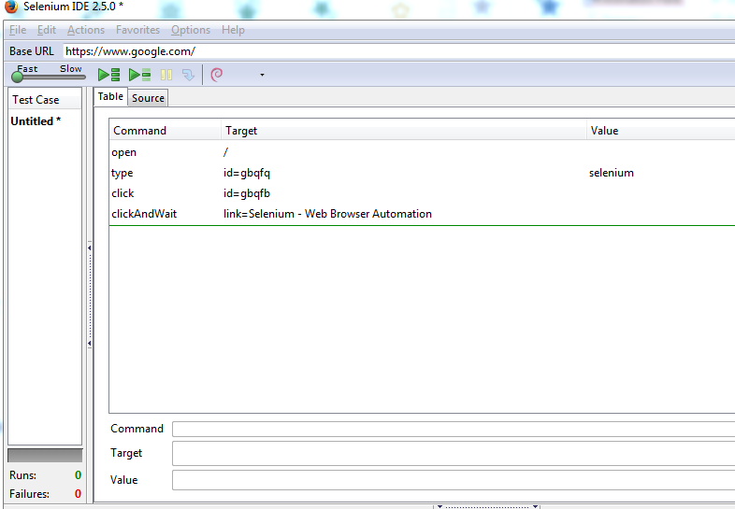
Recording
You can record a script
All you have to do is browse
Go ahead and type “Selenium” and click Search.
Click on the first link
Alt-Tab back to the Selenium IDE

Slide 6
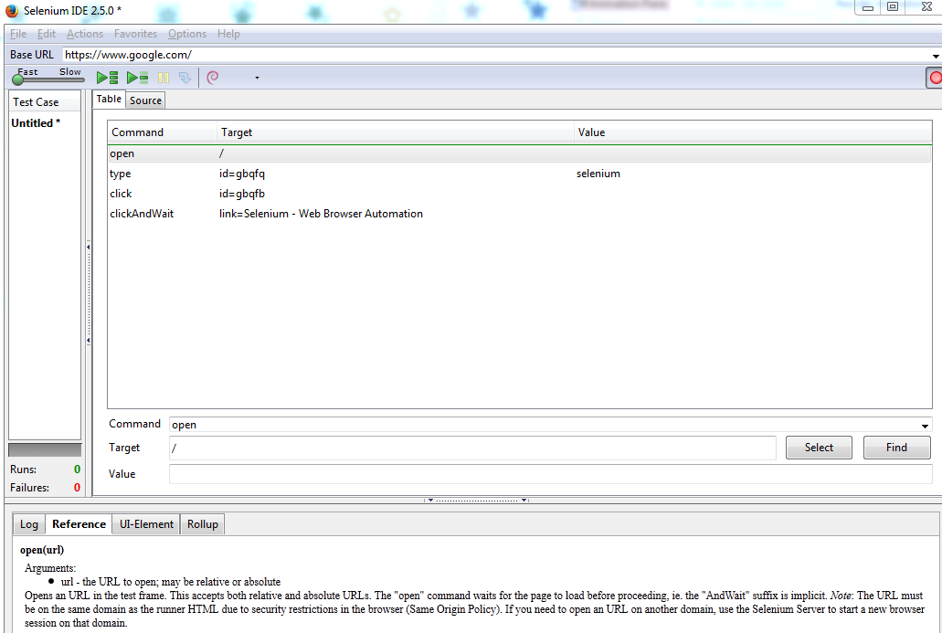
Line by line –Click on “open”
Command is “open”
Target is “/” which “google.com/”
Value is blank
Note the Reference tab

Slide 7
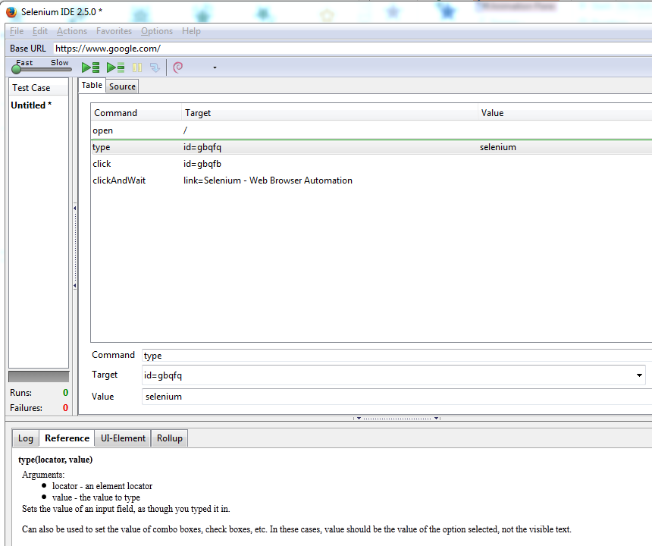
Line by Line-type
Command is “type”
Target is where to type
Value is what to type
So it finds the textbox and types into it

Slide 8
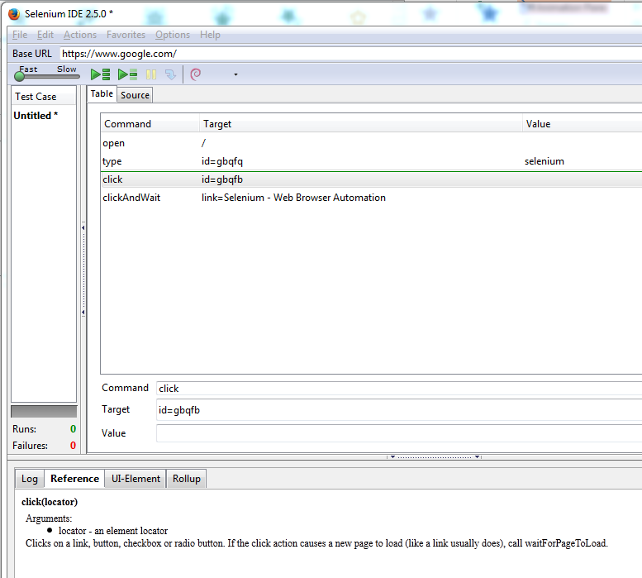
Line by Line-click
Command is click
Target is which item to click
Value is blank
This makes the browser click the given button

Slide 9
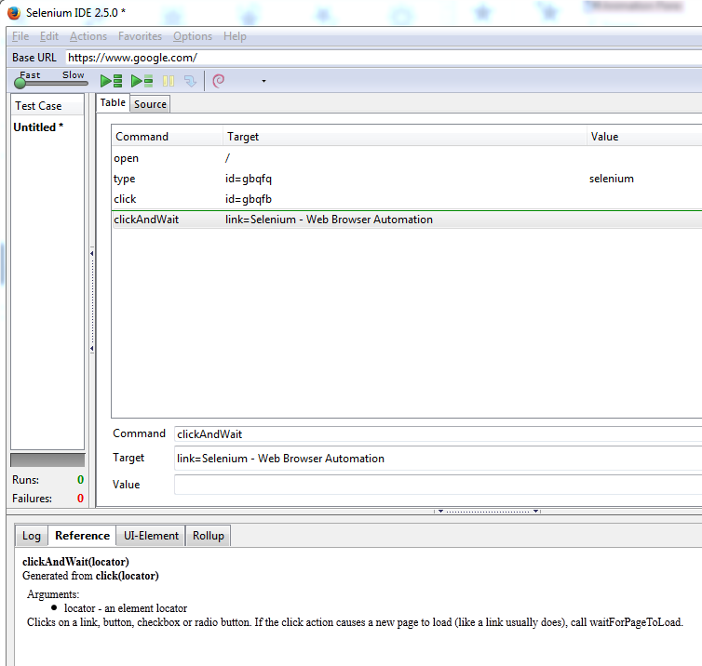
Line by Line-..andWait
Command is clickAndWait
Target is find the link with given text
This clicks the link for us
Note if this text doesn’t exist it will fail
We will see that in a minute

Slide 10
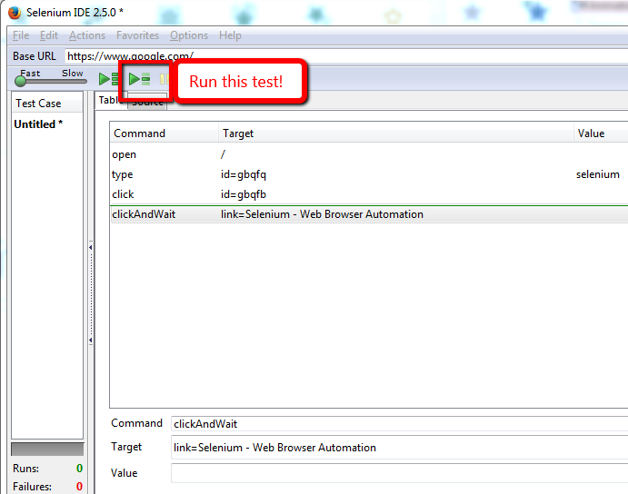
Let’s run with it

Slide 11
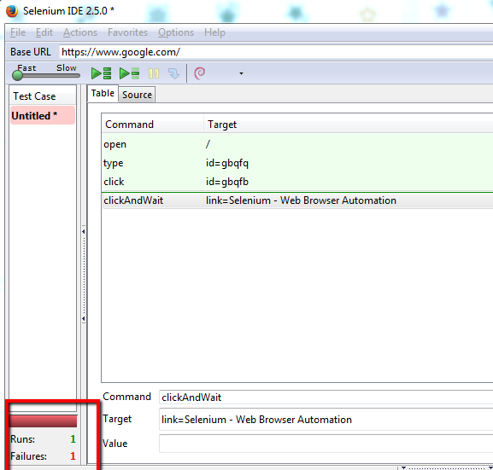
It goes boom
Depending on your computer
Let’s go step by step to find out why

Slide 12
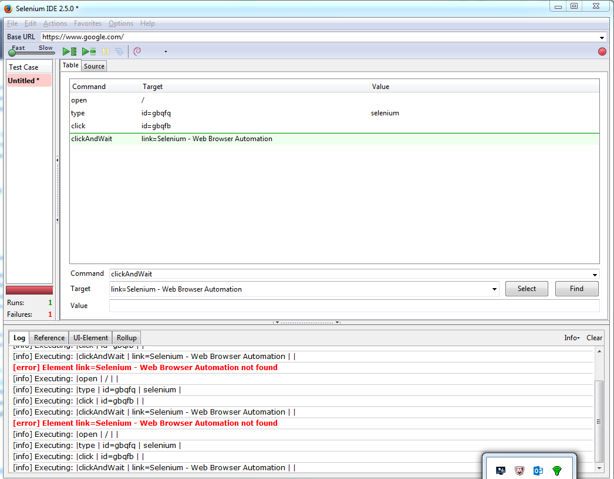
Execute command
Right click on the first line
Click on “Execute This Command X”
Do this for each line
Notice each one works
The line is green if it works
See also the log shows it worked
What is the deal?

Slide 13
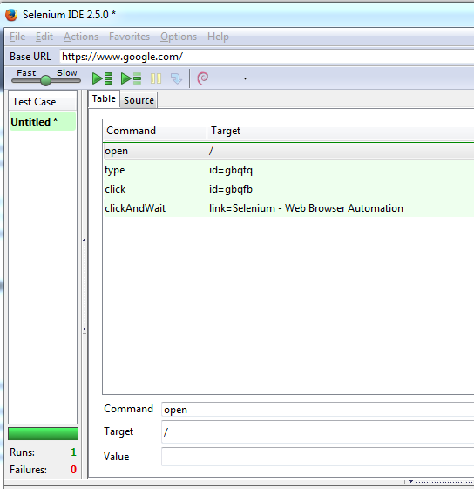
Speed Racer
We can change the speed
It should be green!

Slide 14
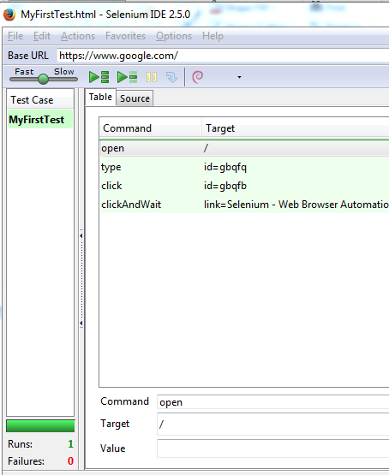
Let’s Save
File-Save Test Case to “MyFirstTest”

Slide 15
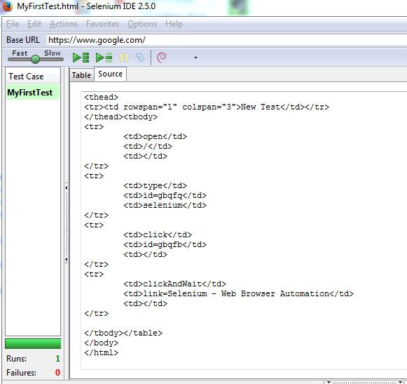
Source code
The code is just an HTML Table

Slide 16
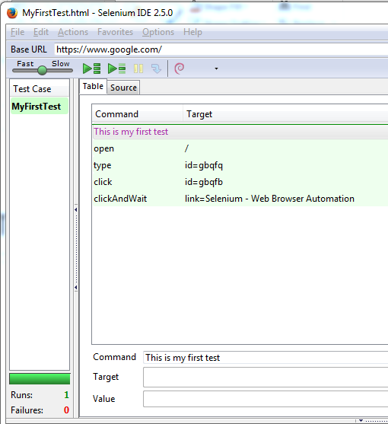
Let’s add a comment
Right-click on first line
Select “Add new comment”
Click in the “Command” textbox.
Enter a comment

Slide 17
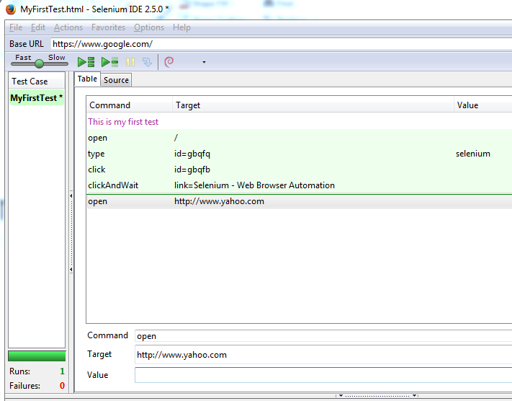
Let’s add a command
Click after the last command
Right-click “Add New Command”
Enter “open” for command
Enter http://www.yahoo.com
Go ahead and test it!

Slide 18
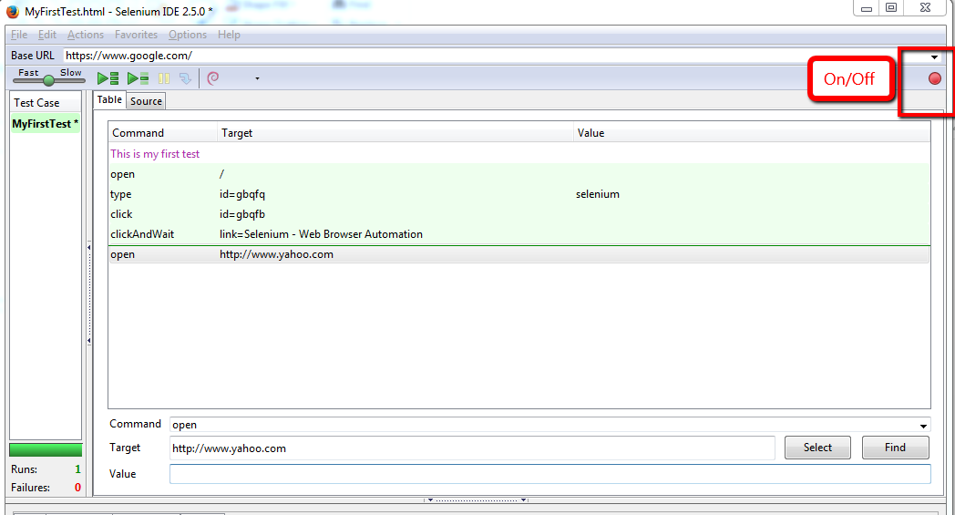
Turning “off”

Slide 19

Saving a suite
Click File ->Save Suite
Call it “My First Test Suite”
Click on Favorites->Add
You can bring it up via the Favorites menu

Slide 20
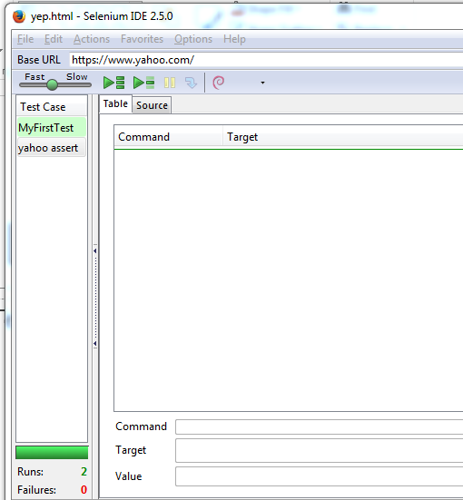
The Suite Life
Select File->Add New Test Case
Click File-> Save Test
Enter “yahoo assert”

Slide 21
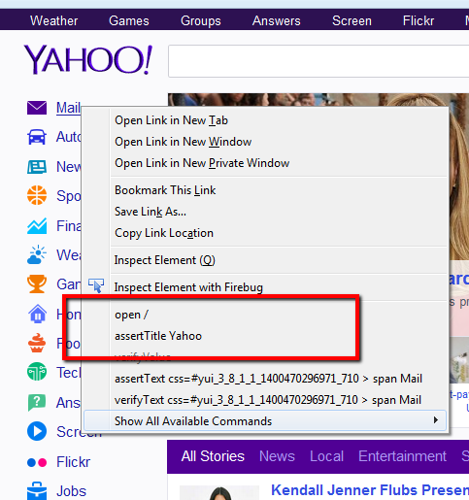
Let’s get assertive
Go to your browser
Type Control-L
Type in “yahoo.com”
Right-click on the page
Select “assertTitle Yahoo”

Slide 22
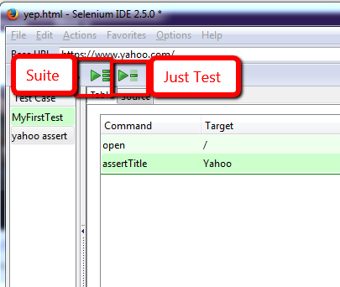
Let’s run it!
You can run the just test
Or you can run the suite

Slide 23
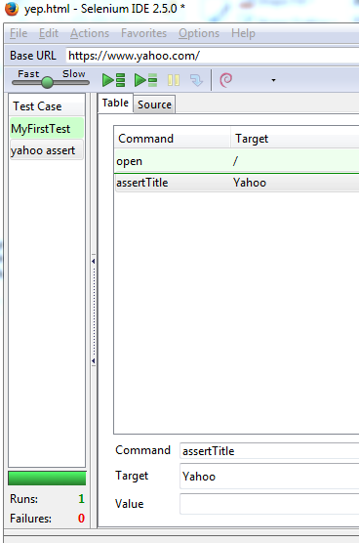
What have we done?
We have verified that
When you to Yahoo
The Title will be Yahoo
Notice the command is “assertTitle”
Target is “Yahoo”

Slide 24
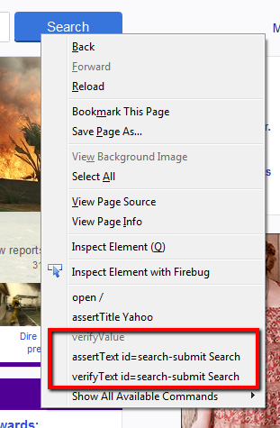
A little harder test
Right-click on the Search Button
Click on assertTextid=search-submit Search
Click on verifyTExt id=search-submit Search

Slide 25
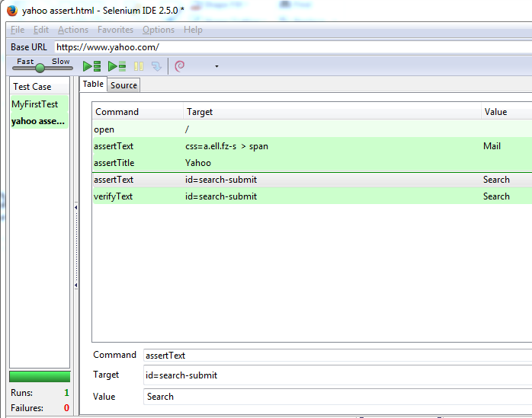
More assertive
Note the structure
Command is asserText
Target is id=search-submit
That is the id of the search button
It figures that out for you
The value is Search

Slide 26
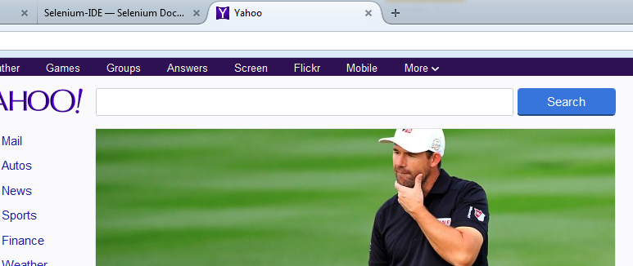
Now what have we proven?
That the search button on Yahoo has a value of “Search
Hmm…

Slide 27

Test your skills
Can you verify if….
If you go to Yahoo
Type in the word “First Test”
Click Search
That when the page comes back it says “First Test” in the textbox
Then put in a comment that says “I Rule” at the end
Save the test as “MyFirstAwesomeTest”
Save the suite as “SuiteLife”
Add it as a favorite

Slide 28
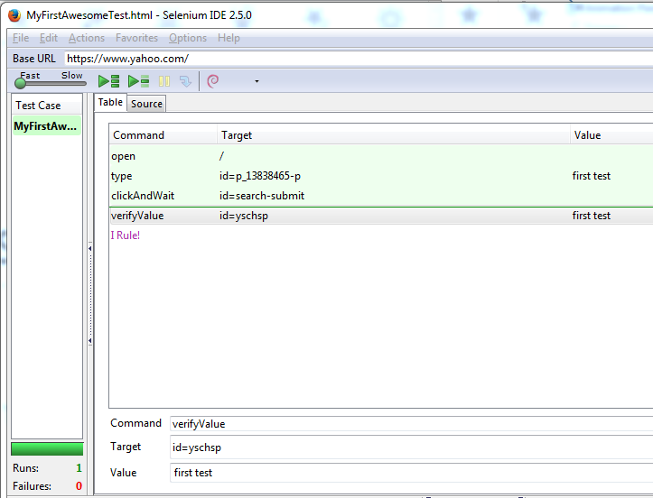
Answer
Yours should look like this

Slide 29
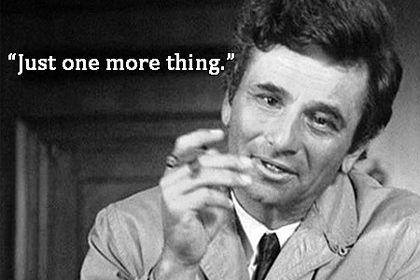
You can use comments for bug reporting
It is often difficult to get steps to duplicate
Selenium has done all that work already
When you encounter a bug
Just jump into the IDE and tell us what should have happened
This will allow us to make a test that shows we fixed it

Slide 30

You can do it!
If you can do this, you can help us document the app
Your steps will be
Open FireFox
Write a comment for what you are doing
Go through the steps of the test
You can verify stuff or not
Save it to folder
The programmers will do the rest

Slide 31
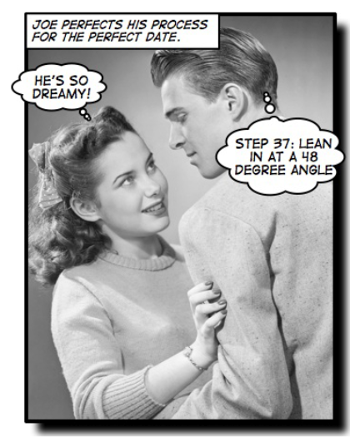
What this accomplishes
We document the steps in the application
We can now play it back to understand what is going on
We can run it to verify that things haven’t changed
It allows to create more robust tests

Slide 32

After you get the hang of this…
I will show you some more advanced Kung Fu Moves
If the test doesn’t work that is OK
I will show you how to fix those things
I will show you the code that you create
Help us automate our tests
It is almost as easy

Slide 33


All we need…
Is for you to record your test
Put it in the right folder
Name it well like
Referrals/FirstTab/VerifyFirstTabSaves

